Slide 1

Edsa-Individual-Electricity-Shortfall-Challenge
Today we will be exploring how exploratory data science can be effectively used in real world problems, its implementation and versatility.

Slide 2
Problem Statement
Our problem statement is to analyze Spain's electrical Shortfall and implement the Exploratory data Methods to check effectiveness renewable energies to solve the shortfall.

Slide 3
An OverView
1.) We will be assessing what electrical shortfall is and how then expletory method cane be implemented to solve them
2.)We will be seeing how Exploratory data science may give us some insight to the problem
3).We will be showing machine learning models can help create a systematic method to predict and prepare for the electrical shortfall,s
4.)And finally we will see sustainability of renewable energys

Slide 4
Analysis of The Problem
What are electrical short falls?
Electrical shortfalls occur when the grid system produces less electricity than demand.
What causes electricity shortfall?
During periods of extremely high demands the Grid Systeam may become over encumbered
What are the effects of electrical shortfalls?
Electrical shortfalls mean that many house hold don’t receive the required power, worse many infrastructure and institutions such as hospitals don’t have enough power to operate

Slide 5
How Will EDA Be Used To solve The Problem
We will be using our will EDA toolkit in a Varity of ways. We will use a simple three step process to solve the problem
firstly we will be using it to understand the data with data engineering principles we will first use vast amounts of "unusable data" and clean and alter it to make meaningful deductions and assessments.
Secondly we will be using this newly acquired information to create Graphs and Tabels to effectively observe the data and search for trends and patterns
Finally we create predict models and paths to test the effectiveness of our proposed solution and if they match our expectations as well as looking at implementation.

Slide 6
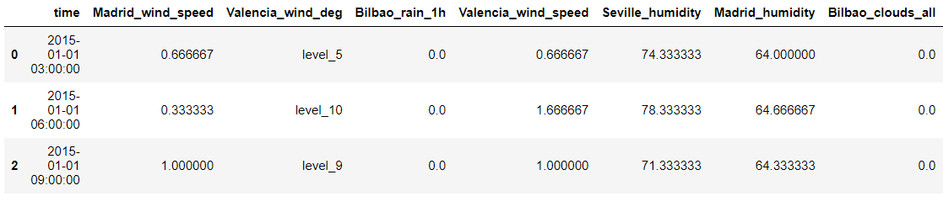
The Sample DATA
Above we have an example of what our data would look like before we "clean it " we can see that through data collection we have been given quite a bit of useful information for or analysis.
We can see that we've been given all the necessary values to see the effectiveness of both wind turbines(wind speed) and solar panel (cloud cover) and most importantly time to evaluate within predictive our model.

Slide 7
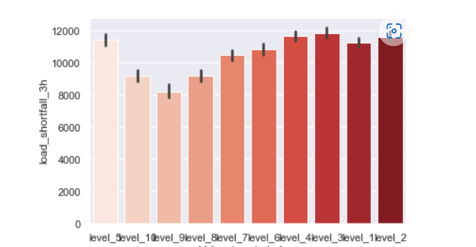
isolation
We can then take only the information valid to our assessment via Python. Above the graph shows wind level compared to load shortfall, we can visually compare the level and load shortfall to see the viability and deduce that wind may be usable choice to overcome the load shortfall

Slide 8
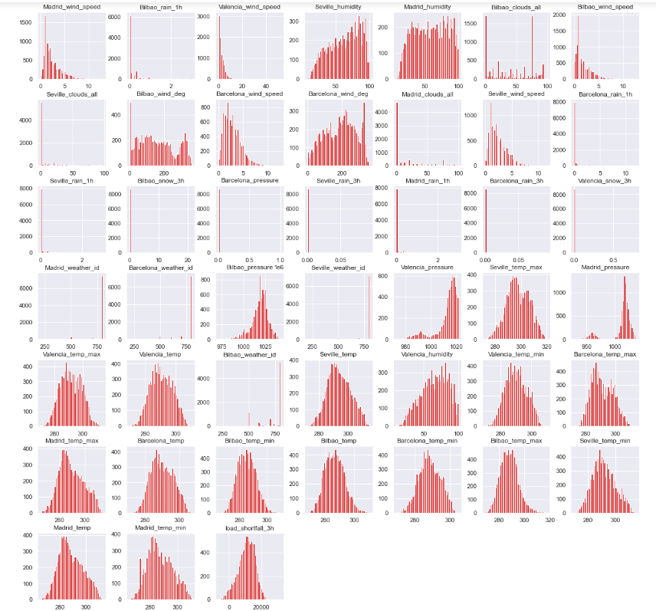
Pandas Integration
What is Pandas: pandas is a very powerful python tool that allows us to create multiple complex graphs more effectively and effectively allowing for visualization of large amounts of information
*please forgive the image quality

Slide 9

Machine learning
Before we continue first we must explore what machining learning is and how we use it in EDA

Slide 10
What is machine learning
The use of complex mathematical models that allow machines to accurately predict without direct instruction.
It becomes invaluable in the use of big data analysis as normal human beings would struggle to create effective models with such large amounts of information

Slide 11
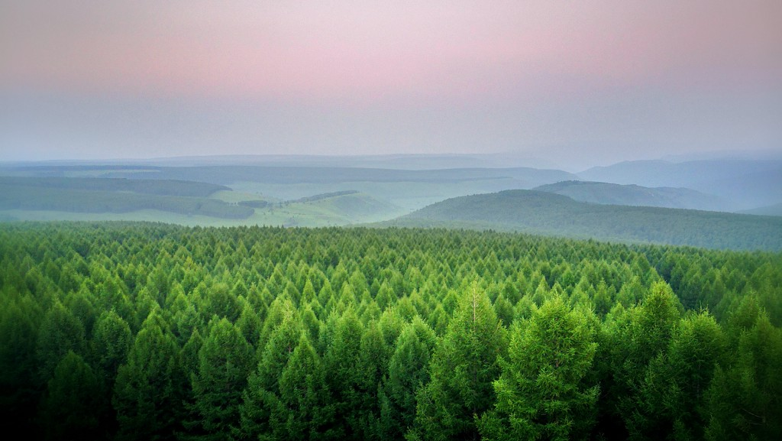
The random forest machine learning model
The random forest is a machine learning model which uses algorithms consisting of multiple decision trees. The final predication is Made by evaluating the Average of the ensemble.

Slide 12
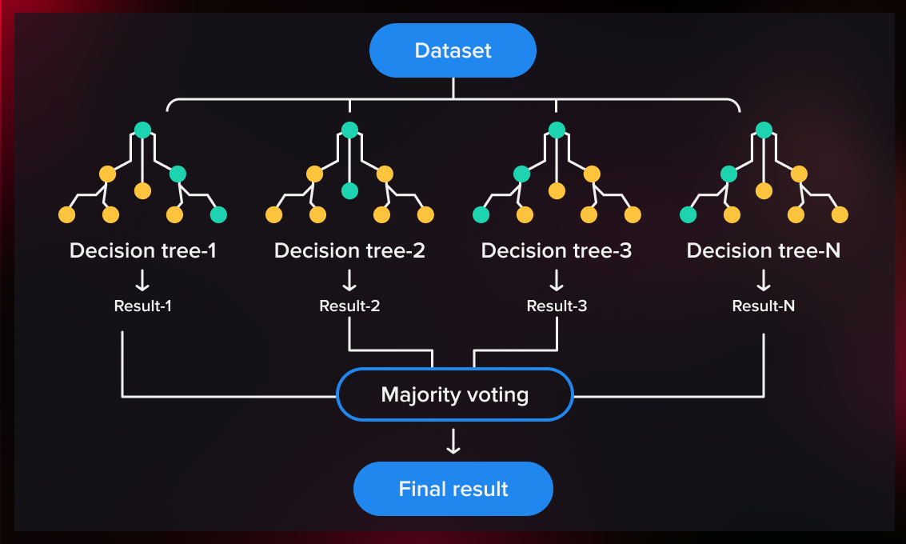
More about the random forest

Slide 13

Machine learning Model Evaluation
We Used our random forest predictive model to evaluate the information and We obtained a score of 3650, With this score we can assume that implementing renewable energy would be a viable solution to the shortfall problem

